Slide 1
<number>
Project Presentation
Presented By –
Parvez Hassan
Shiv Ratan Kulhari
Notes:
<number>

Slide 2
<number>
PROJECTS :
Face Recognition Application Using MATLAB.
REAL Time Chat Web App Using Nodejs and MongdB.
/*Android Quiz App (updated version of 1st semester project )*/

Slide 3
<number>
1. Face Recognition
Face recognition is the process of identifying one or more people in images or videos by analysing and comparing patterns. Algorithms for face recognition typically extract facial features and compare them to a database to find the best match. Face recognition is an important part of many biometric, security, and surveillance systems.
About MATLAB
Concept's and tools used
Process and working
Limitations and Future Scope

Slide 4
<number>
MATLAB
MATLAB® is the high-level language and interactive environment used by millions of engineers and scientists worldwide. It lets you explore and visualize ideas and collaborate across disciplines including signal and image processing, communications, control systems, and computational finance.
Capabilities-
Numeric Computation
Data Analysis and Visualization
Programming and Algorithm Development
Application Development and Deployment

Slide 5
<number>
Concepts and Tools Used :
Computer Vision MATLAB Toolbox
Image Processing MATLAB Toolbox
Feature Extraction (HOG Features)
Machine learning Techniques(ECOC)

Slide 6
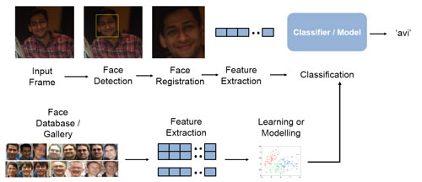
<number>
Process :

Slide 7
<number>
Limitation And Future Scope :
Real Time Face Recognition
Accuracy of recognition is not that accurate for photos of face with different angle and light intensities because of HOG feature Capabilities.
No GUI
Real time Dataset Generation

Slide 8
<number>
2. Real Time Chat Web Application
About
Developed using
Interface and Working
Limitations and Future Scope

Slide 9
<number>
About :
A server-client Real time Chat Application using NodeJs , Socket.io , MongoDB and ExpressJS.
Writing a chat application with popular web applications stacks like PHP has traditionally been very hard. It involves polling the server for changes, keeping track of timestamps, and it’s a lot slower than it should be.
Sockets have traditionally been the solution around which most real-time chat systems are architected, providing a bi-directional communication channel between a client and a server.
This means that the server can push messages to clients. Whenever you write a chat message, the idea is that the server will get it and push it to all other connected clients.

Slide 10
<number>
Developed using :
HTML / CSS
Nodejs
Socket.io
Express JS
MongodB

Slide 11
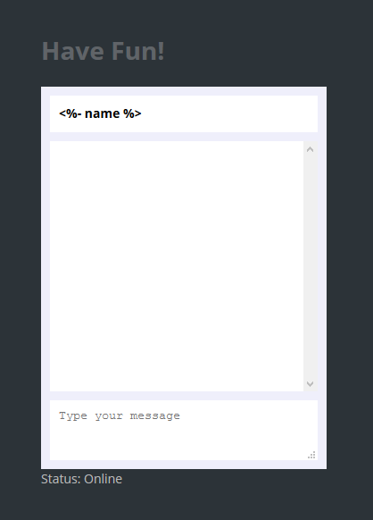
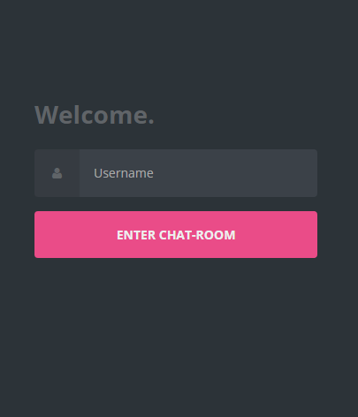
<number>
Interface

Slide 12
<number>
Limitations and Future Scope
Limited to Text Messages.
No Emoticons.
No unique Alias checking

Slide 13
<number>
3. Friends Trivia
Android Quiz App
Now we are retreving the questions,answers and options from database.
We have added share intents.
For Facebook And Twitter .
Imporved UI
We Will show you the Code and App Directly.

Slide 14
<number>
Thank you.

